Slide 1


BIOMETRIC AUTHENTICATION SYSTEM

Slide 2


PROBLEM:
ENHANCING SECURITY THROUGH IMAGE FEATURE RECOGNITION

Slide 3
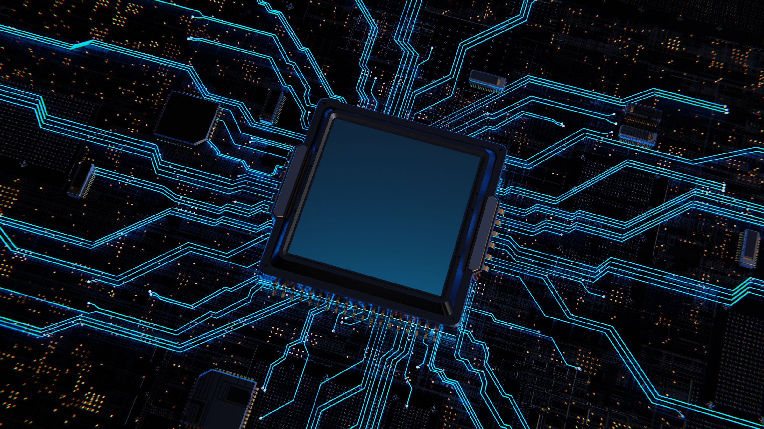
INTRODUCTION
WHAT IS THE USER IMAGE DATA SECURITY SYSTEM?
A system designed to securely store and utilize user image data for authentication and security purposes.
WHY THIS SYSTEM?
Traditional security systems rely heavily on passwords or PINs, which are prone to theft and misuse.
Biometric image data ensures enhanced security and user identity verification

Slide 4
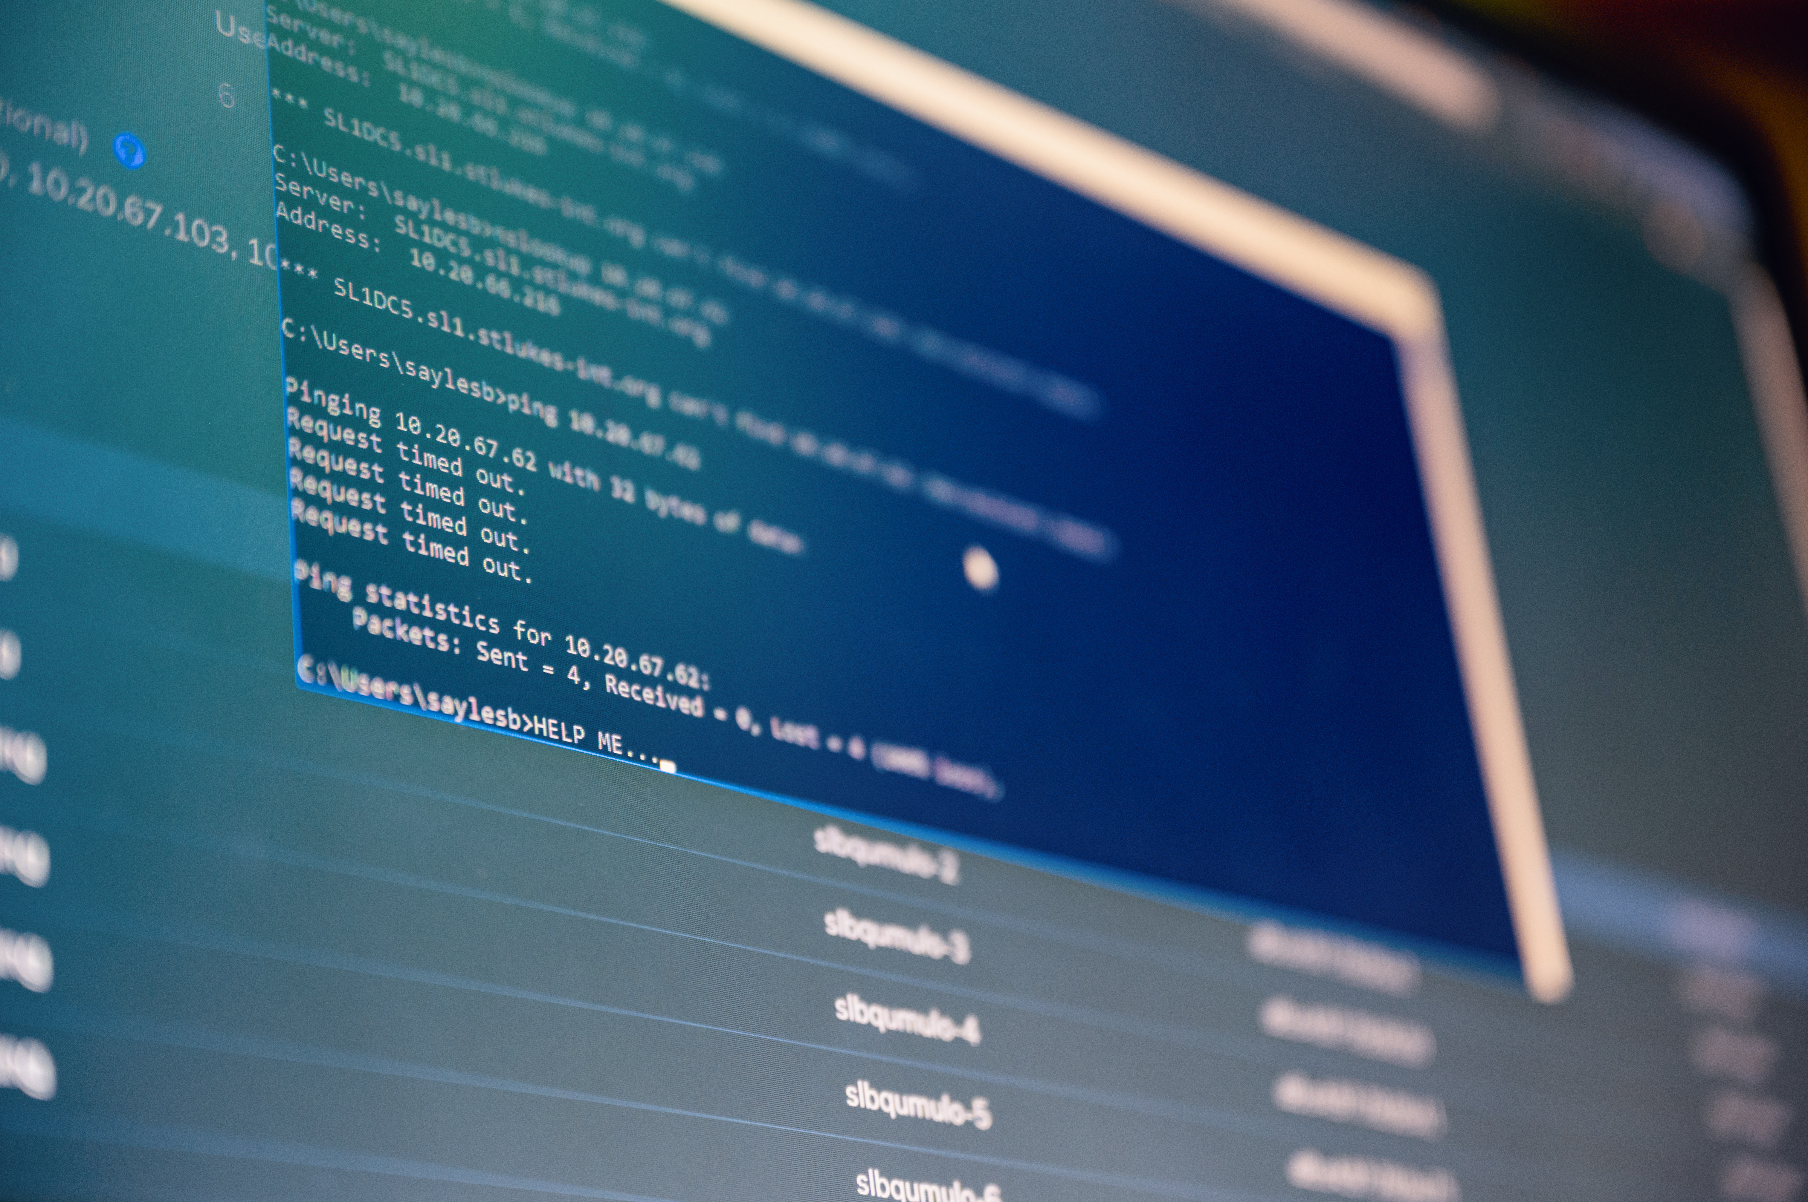
80% of security breaches involve stolen or weak authentication systems.
Need for a robust and secure system to store and authenticate user data.
GLOBAL CONCERNS:

Slide 5
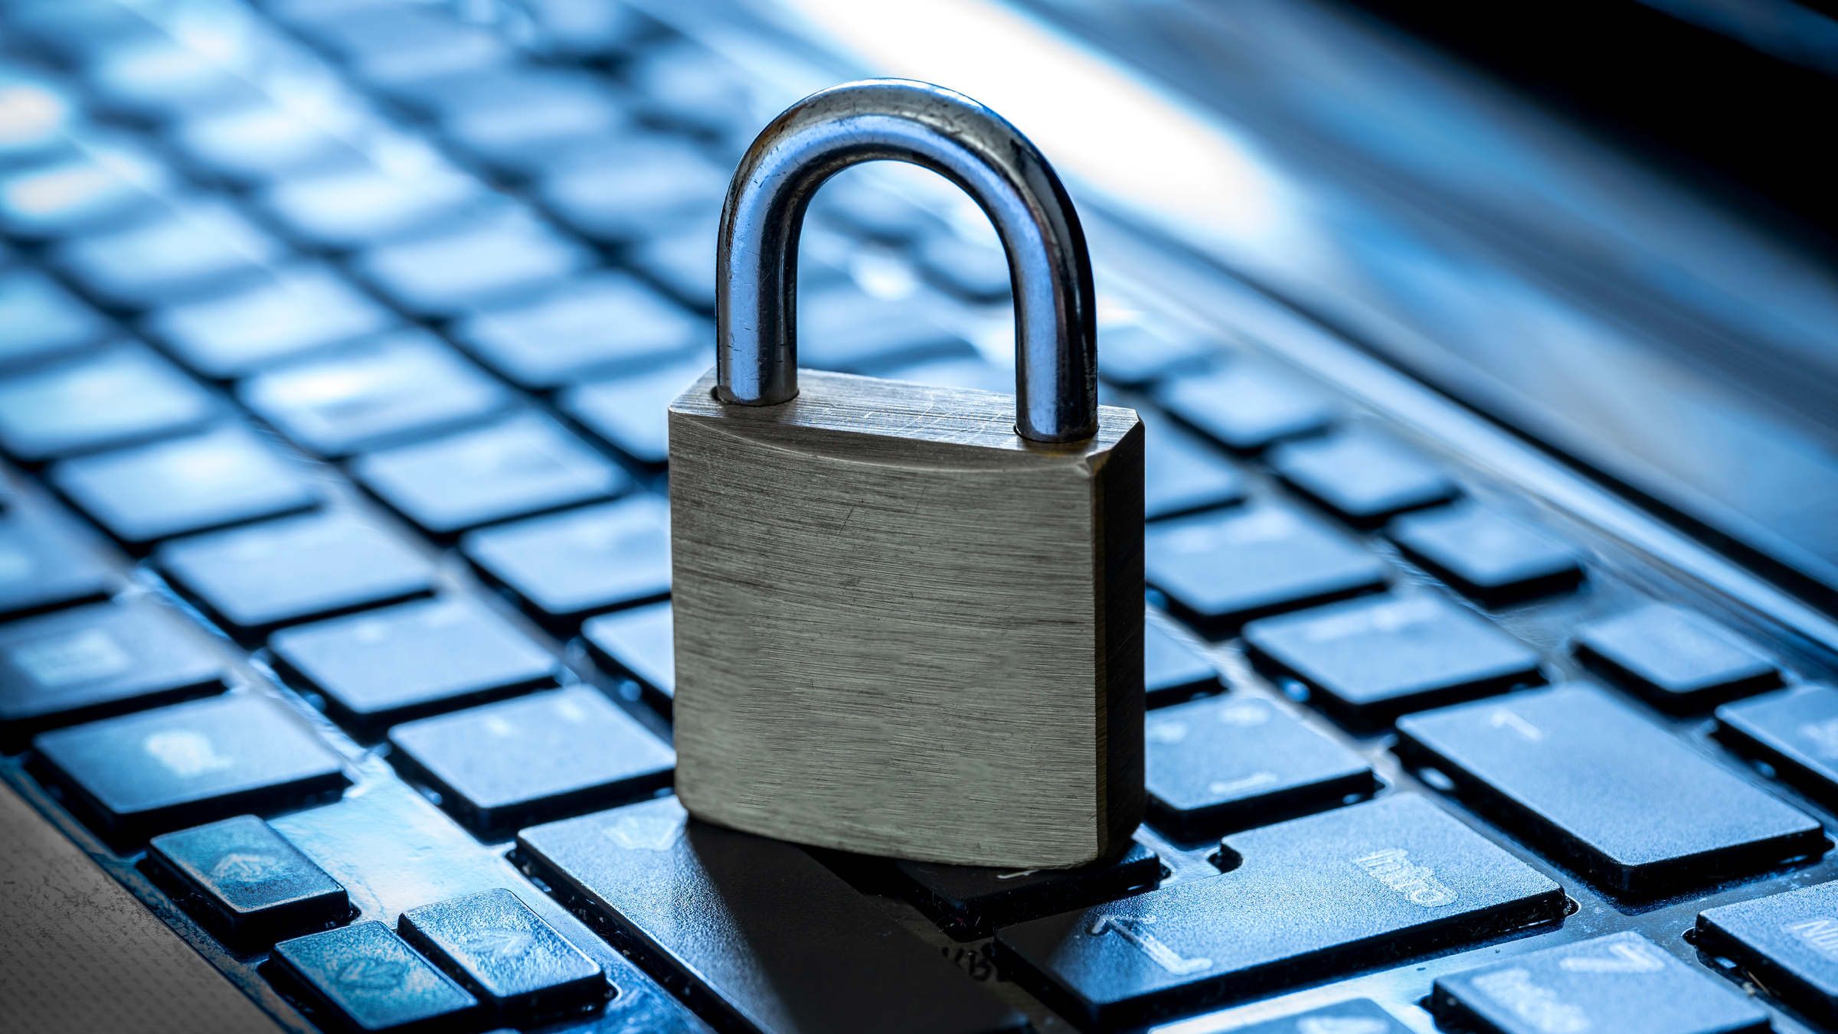
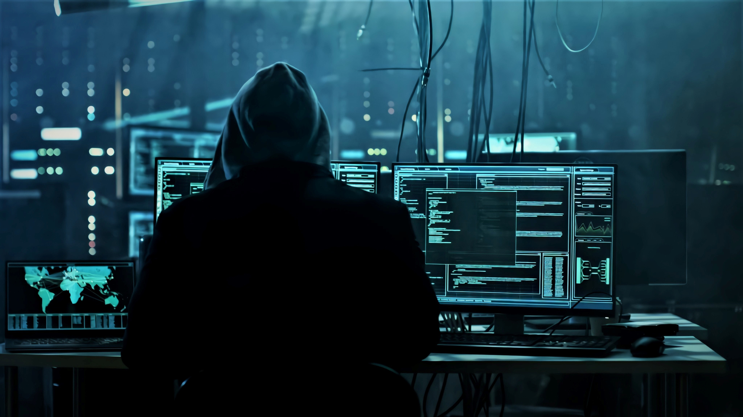
PROPOSED SOLUTION
OUR APPROACH
Securely capture, preprocess, and store user image data.
Utilize advanced machine learning models to extract and verify unique features.
Implement encrypted storage and liveness detection mechanisms.

Slide 6

TECHNOLOGIES USED:
SOFTWARE :
PROGRAMMING LANGUAGE: Python
LIBRARIES: OpenCV,TensorFLow/Keras
HARDWARE :
Highly-resolution cameras for image capture.
Computational hardware with GPU support for ML inference

Slide 7
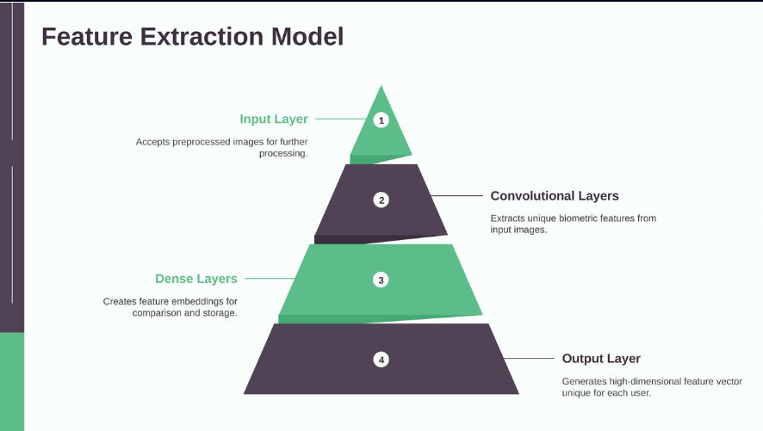

Slide 8
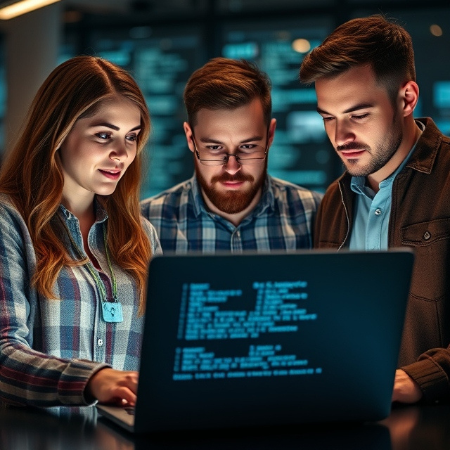
CHALLENGES
LOW-LIGHT: DIFFICULTY IN CAPTURING CLEAR BIOMETRIC IMAGES UNDER VARIOUS LIGHTING CONDITIONS.
PROCESSING TIME: NEED TO BALANCE SPEED AND ACCURACY FOR REAL-TIME USER AUTHENTICATION.
SPOOF PREVENTION: ENSURE THE SYSTEM RELIABLY DETECTS AND REJECTS MANIPULATED OR FAKE IMAGES.
USER PRIVACY: PROTECT SENSITIVE BIOMETRIC DATA FROM UNAUTHORIZED ACCESS AND BREACHES.
INTEGRATION ISSUES: CHALLENGES IN MERGING BIOMETRIC SYSTEMS WITH EXISTING SECURITY INFRASTRUCTURE.
Data Storage: Manage large volumes of image data without compromising security or performance.
Model Training: Continuous need for high-quality datasets to improve machine learning accuracy.
User Experience: Strive for a seamless process while maintaining security protocols.

Slide 9
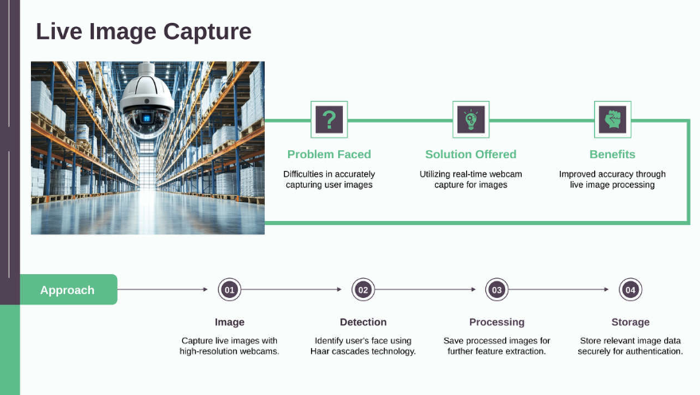

Slide 10
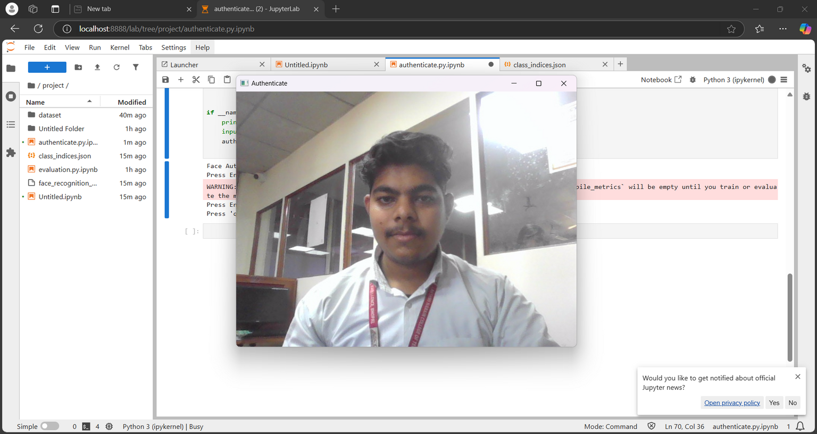
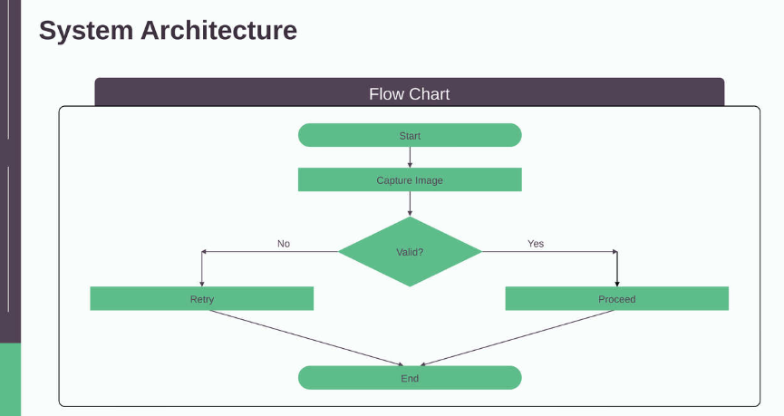
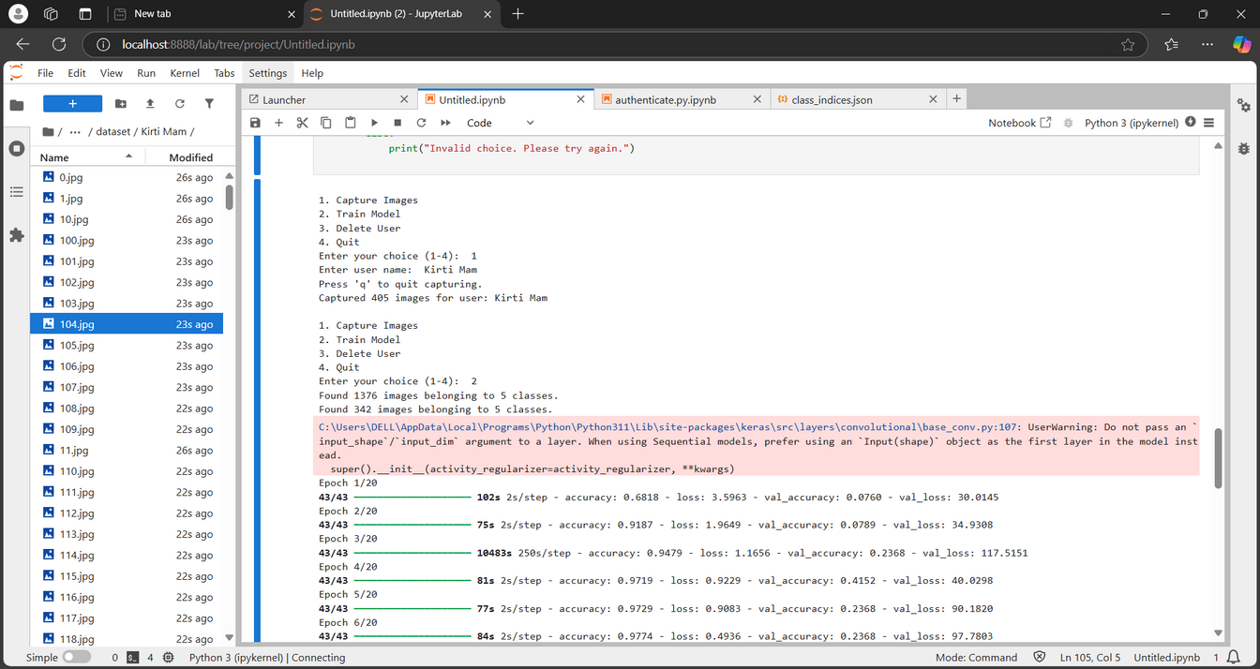
CAPTURING THE LIVE IMAGE

Slide 11
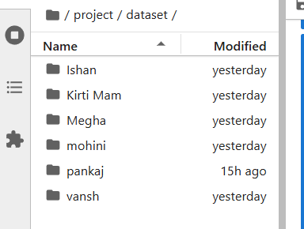
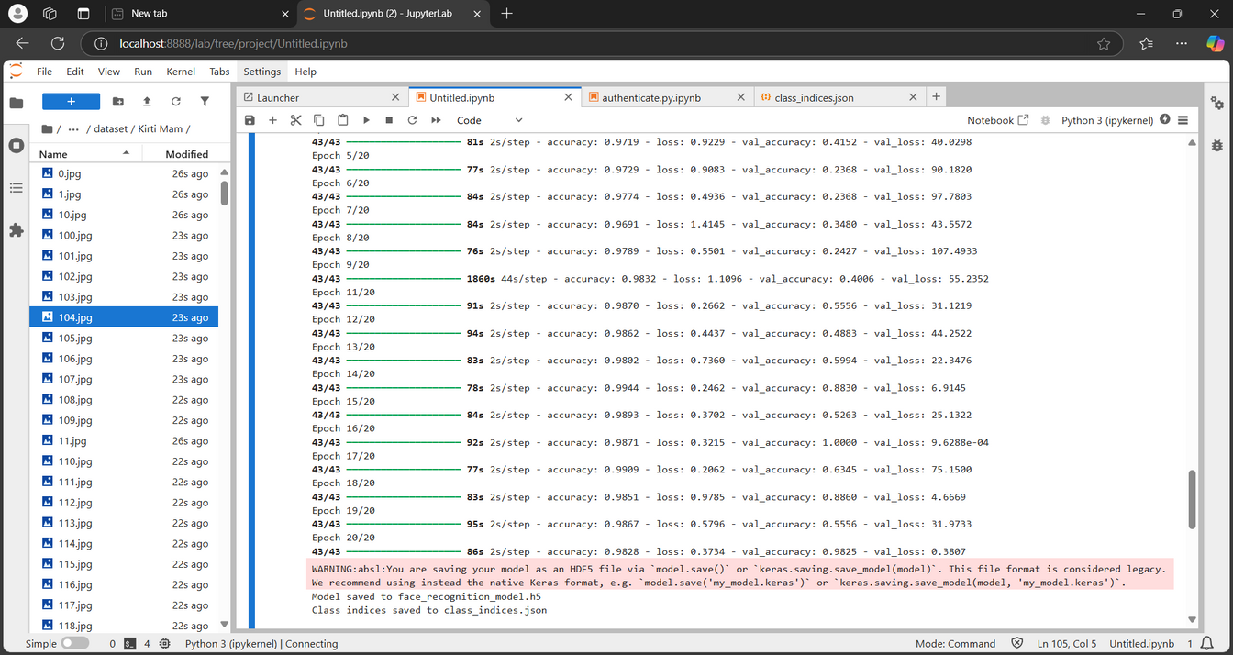
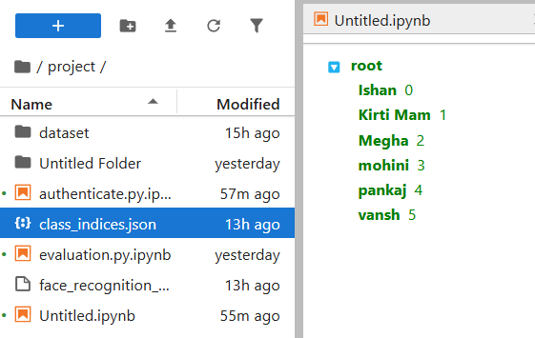
Training Model

Slide 12
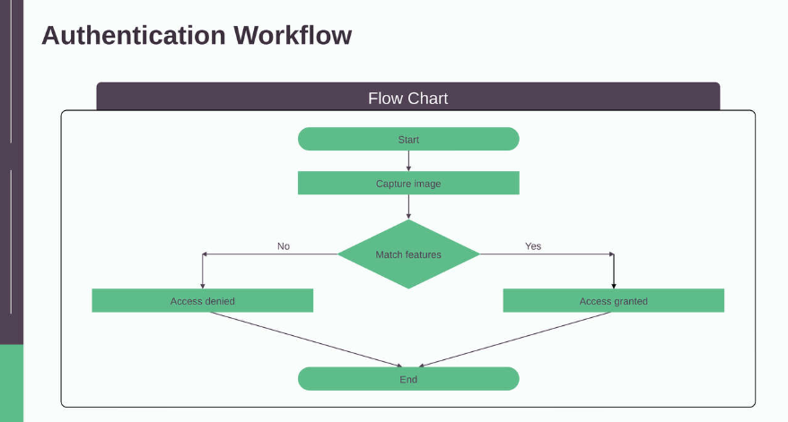
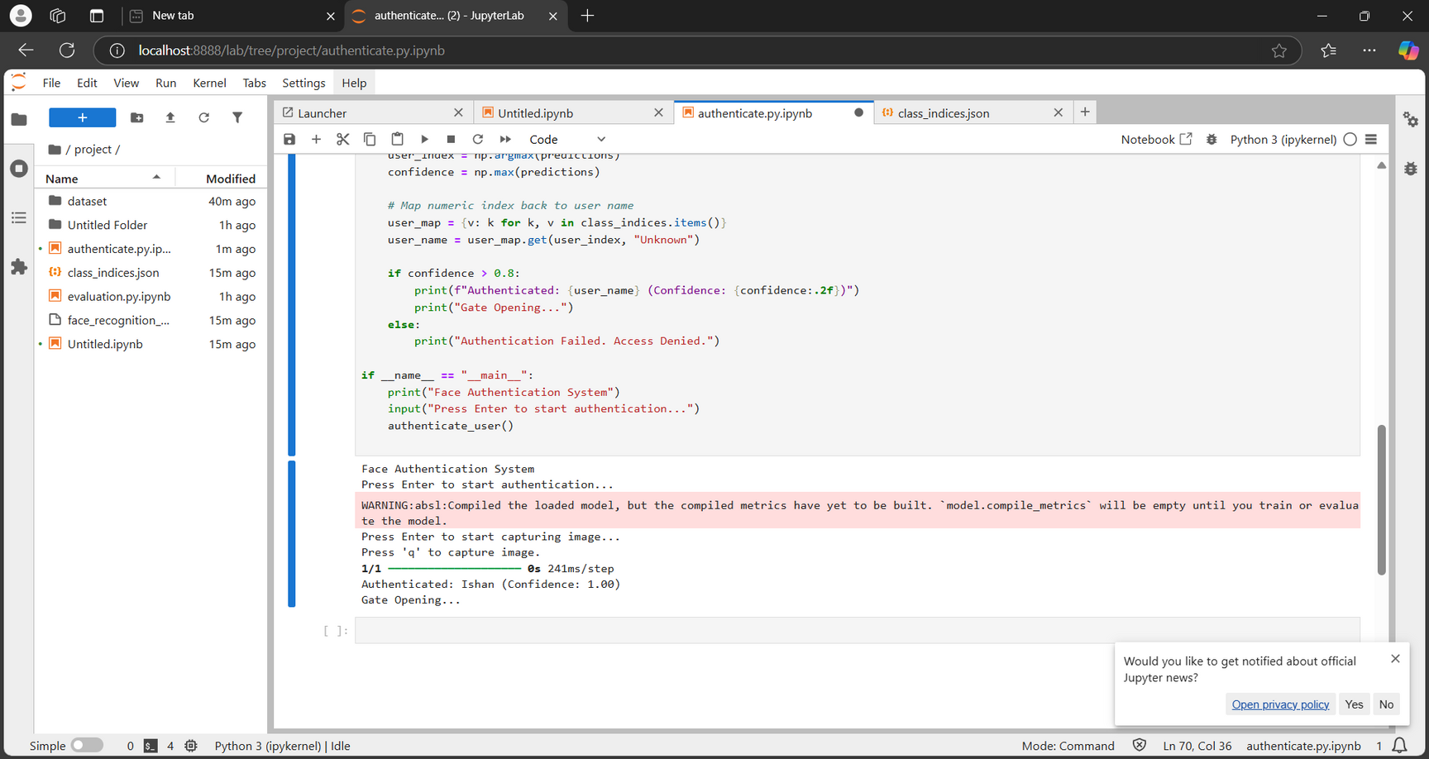
Authentication
Authentication Workflow

Slide 13
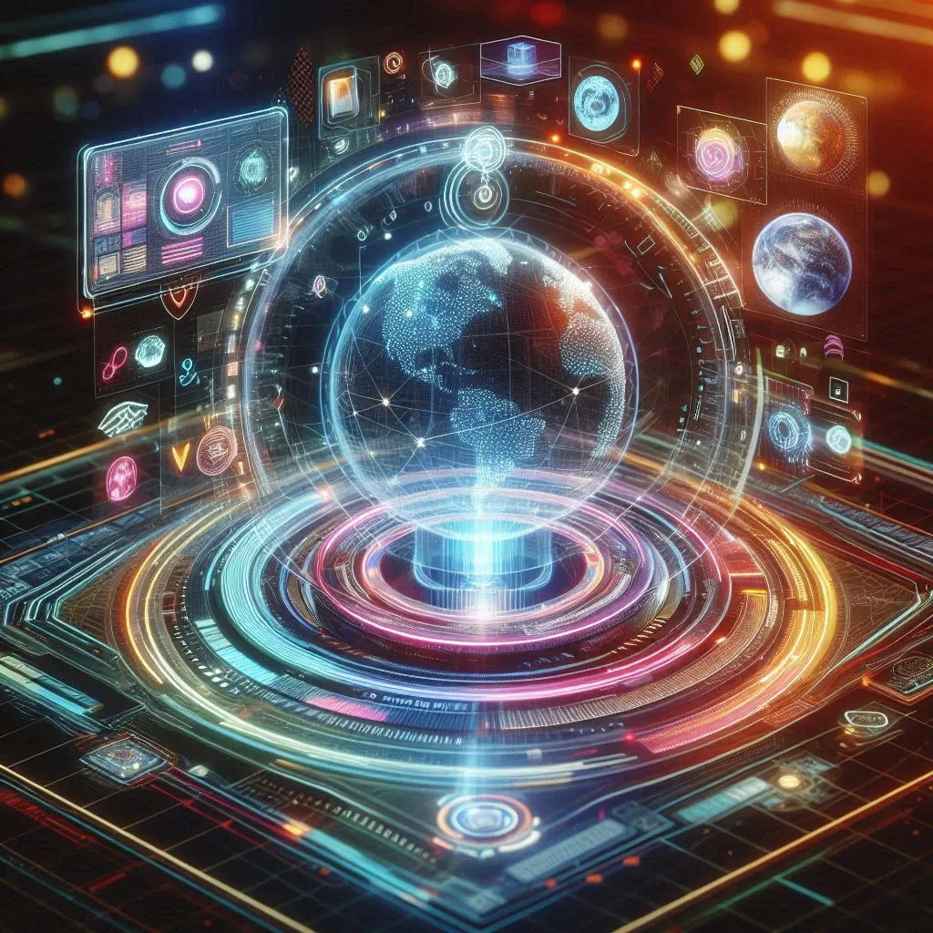
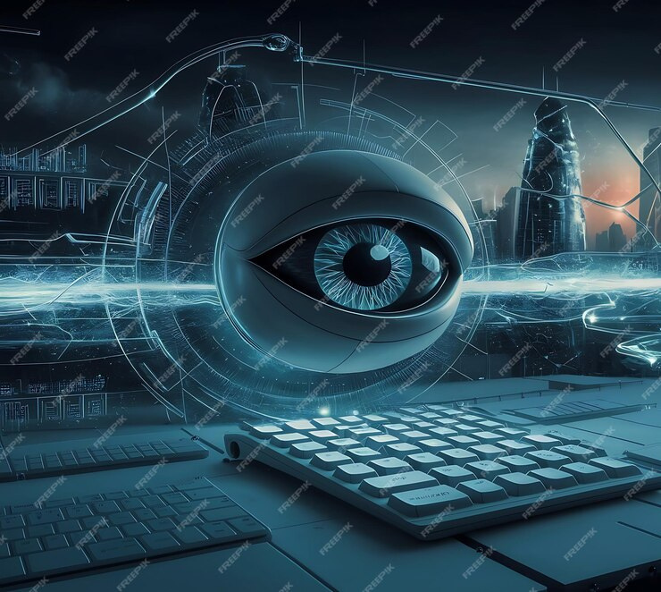
FUTURE ENHANCEMENTS
MULTI-MODAL BIOMETRICS
Integrate voice and fingerprint authentication for improved security and user convenience across various platforms.Up to 30% increase in accuracy over single methods.
CLOUD INTEGRATION
Implement real-time processing capabilities in the cloud to accommodate a growing number of users and transactions. 20% enhancement in identification accuracy via real-time analysis.
ADVANCED ML MODELS
Adopt transformer models to enhance feature extraction and improve accuracy in distinguishing user identities.Potential for a 25% boost in overall model accuracy.

Slide 14
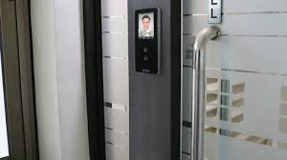
CONCLUSION
Enhanced Security
The system provides robust protection against unauthorized access.
User-Friendly Authentication
Biometric data eliminates the need for traditional passwords.
Scalable Implementation
Easily adaptable to various industries and applications.
Advanced Technology Utilization
Integration of machine learning improves accuracy and efficiency.

Slide 15
THANKYOU

